Slide 1
Adding Quality to People‘s Lives
Georg Fischer Waga N.V.
Georg Fischer Waga N.V., Lange Veenteweg 19, 8161 PA Epe
The Netherlands

Slide 2
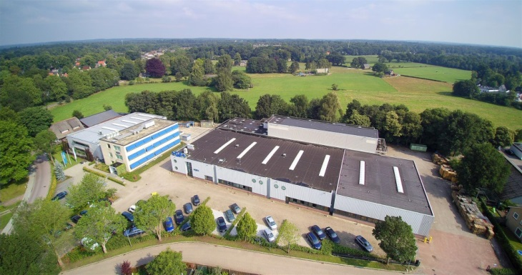
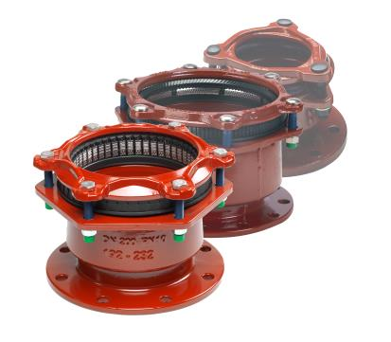
Georg Fischer Waga N.V.
Since 1957 Georg Fischer Waga N.V. designs, produces and sells a complete range of: couplings, flange adaptors, repair fittings, tapping tools, saddles, tees and accessories.
Important milestones:
1957 foundation of Waga N.V.
1965 joined the GF family
1990 launch MULTI/JOINT® 2000
1997 launch MULTI/JOINT® 3000
2008 launch MULTI/JOINT® 3000 Plus
2015 launch of DN425 - DN600

Slide 3
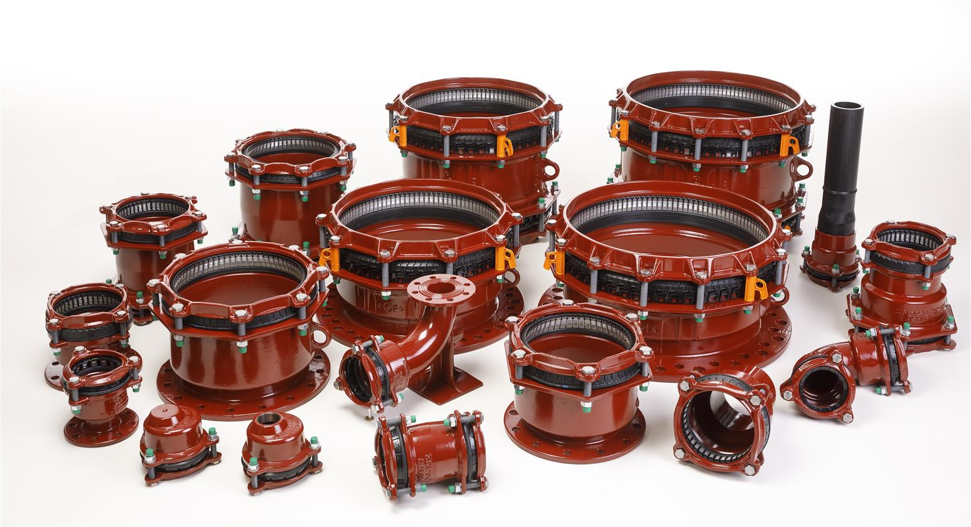
MULTI/JOINT® 3000 Plus:
For all your connection challenges from DN50 - DN600

Slide 4
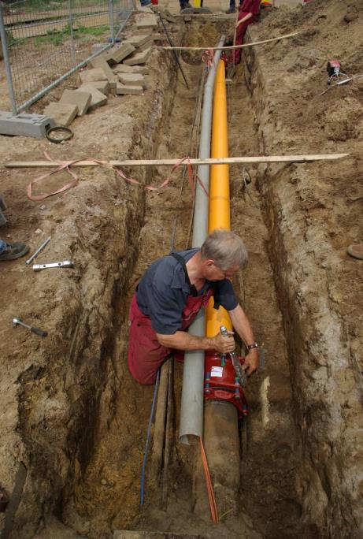
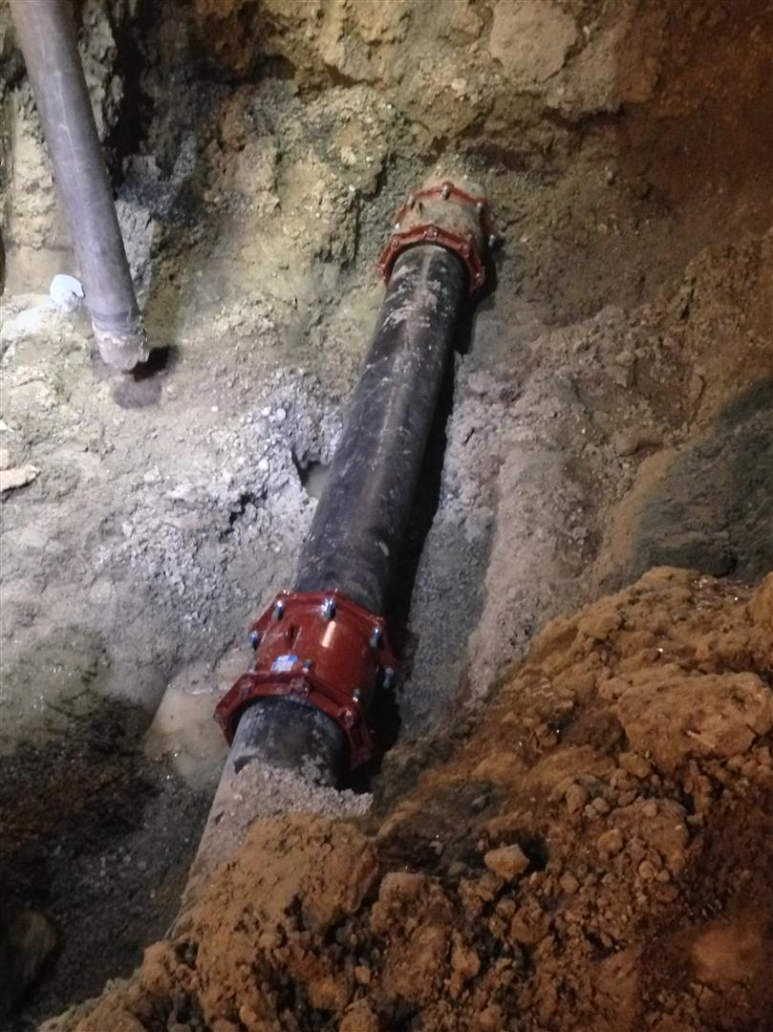
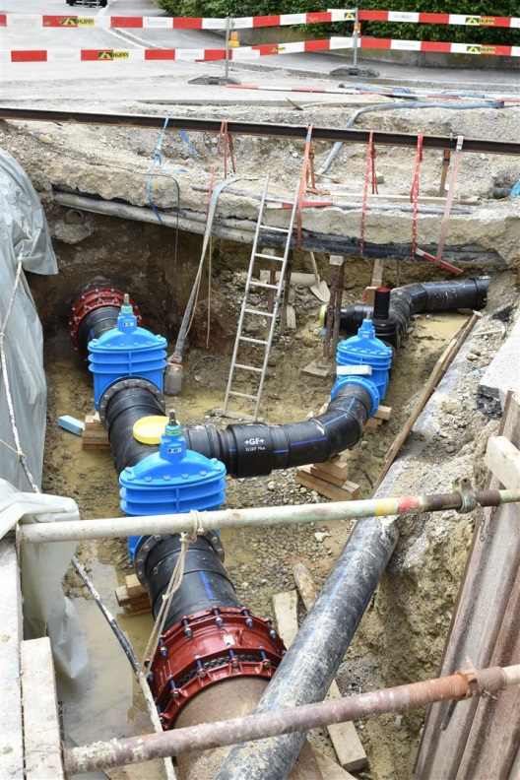
Core competence
Renovating existing lines, making (emergency) repairs and making extensions in existing lines. Transitioning from the “old” to the “new” world. Thanks to the “one size fits and grips all principle”.
Maintenance
Repair
Extentions

Slide 5
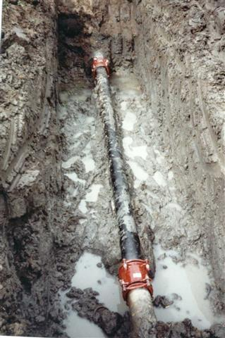
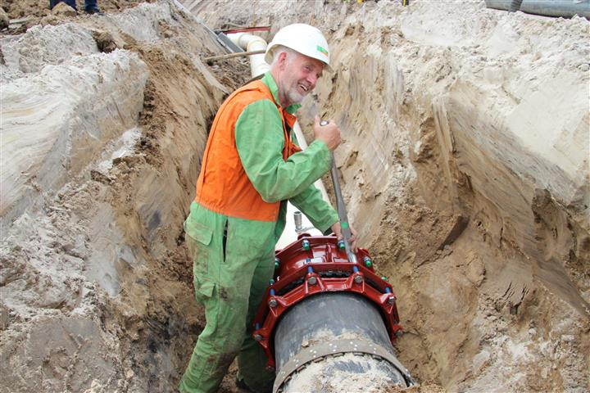
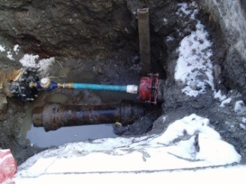
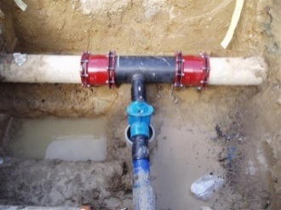
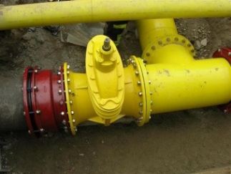
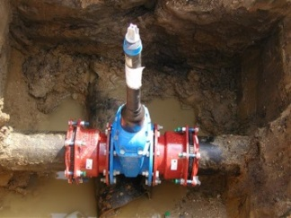
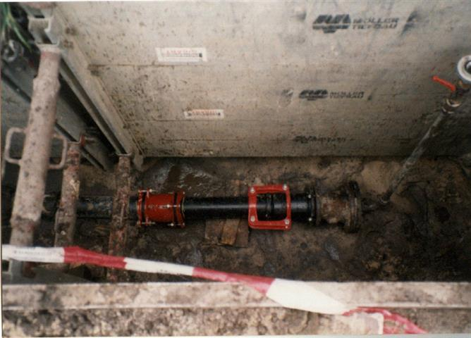
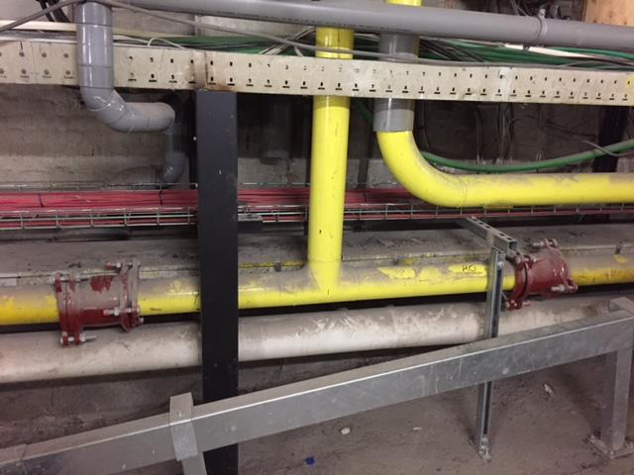
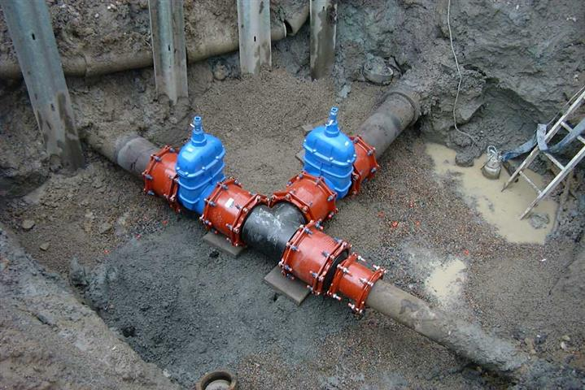
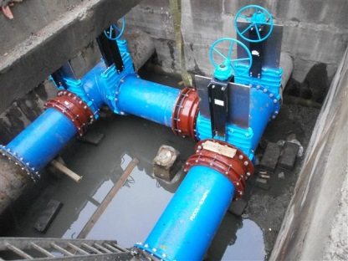
Benefits:
Peace of mind
Proven quality and international track record since 1957!

Slide 6
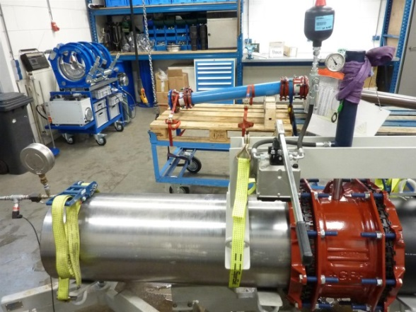
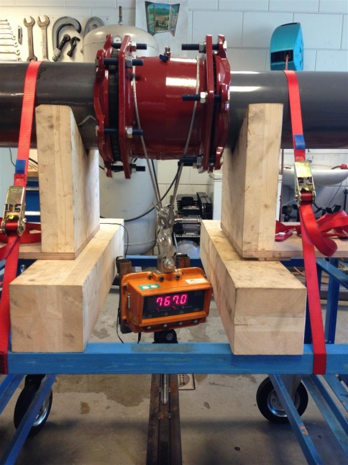
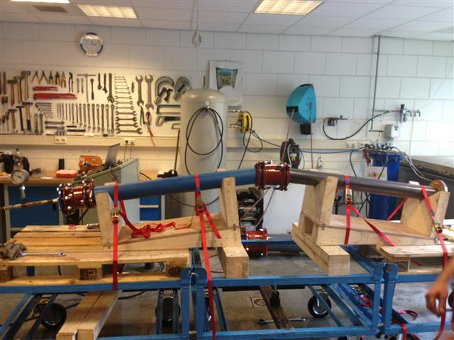
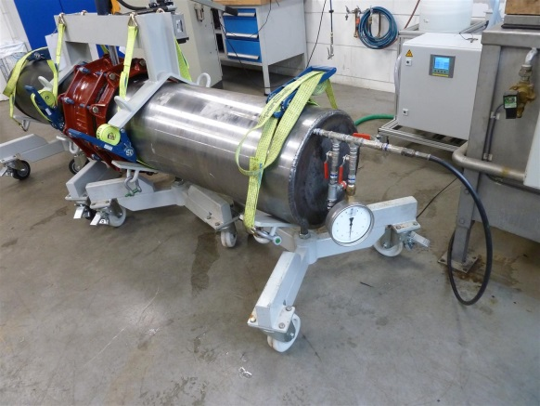
Benefits:
Lowest total cost of ownership
Designed for a technical life expectancy of at least 50 years. Certified according EN 14525 for water and KE 208 for gas.

Slide 7
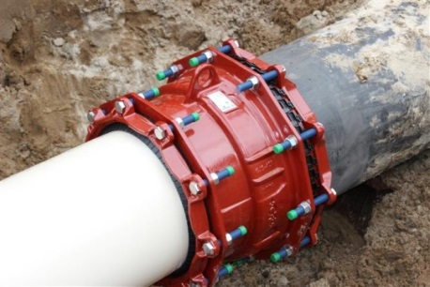
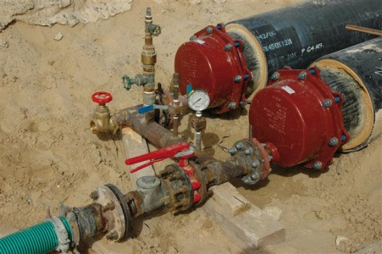
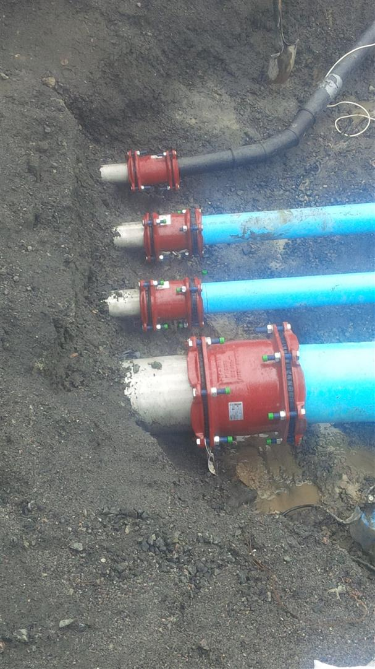
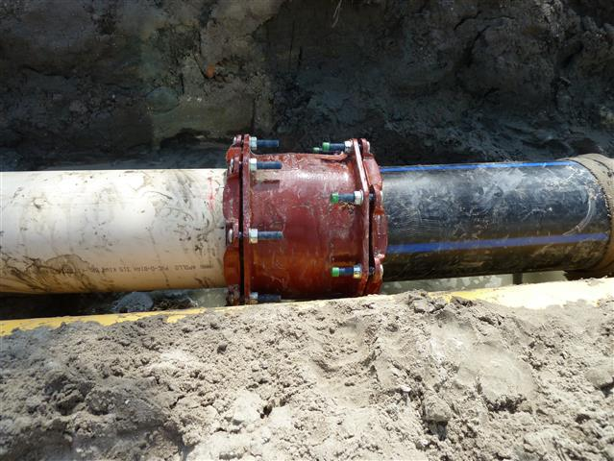
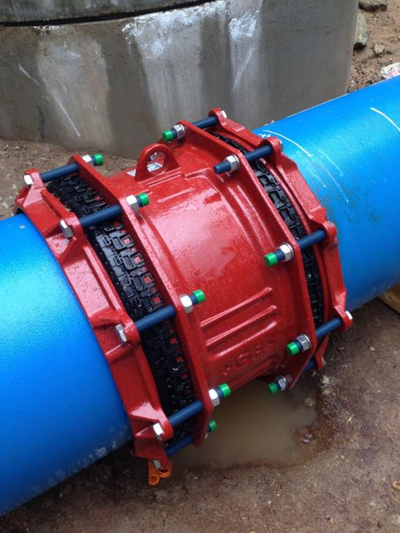
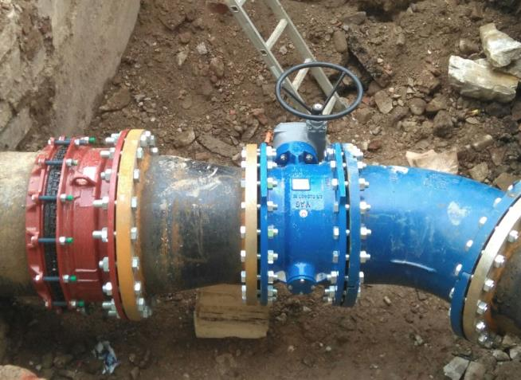
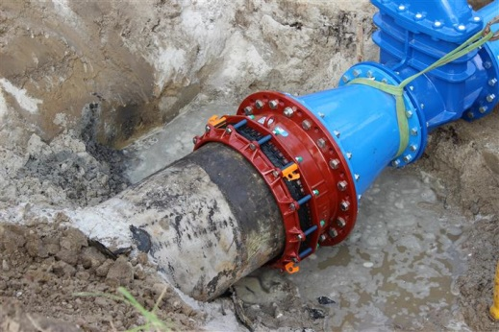
Benefits:
Suitable for all pipe materials and reusable
Such as: (D)CI, AC, PE, PVC, GRP and (Stainless) Steel.

Slide 8
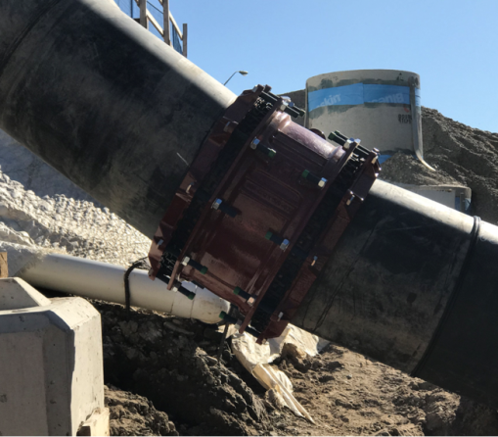
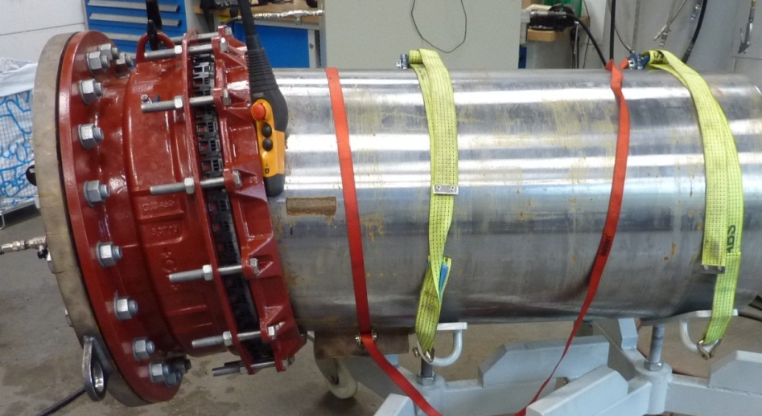
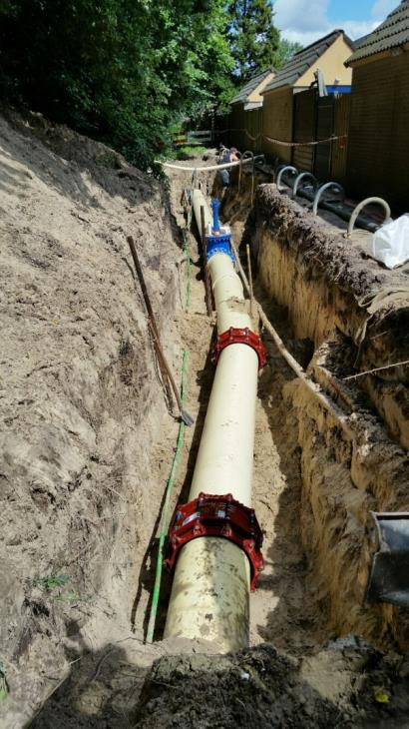
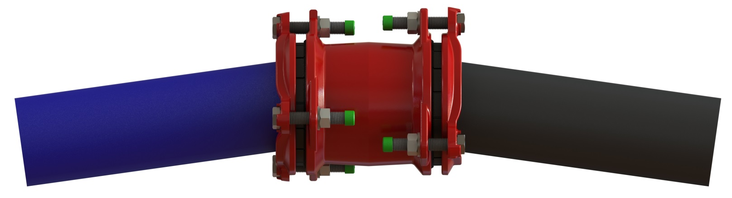
Benefits:
Ease of installation
Maximum 8º of angularity* per socket end (16º for a coupling).
8°
8°
16°
16°
* Based on the middle of the fitting range

Slide 9
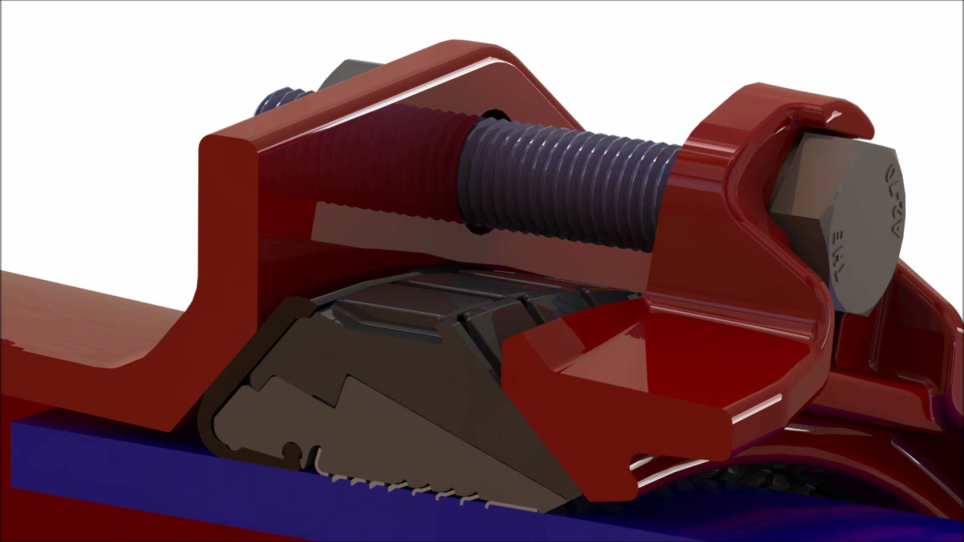
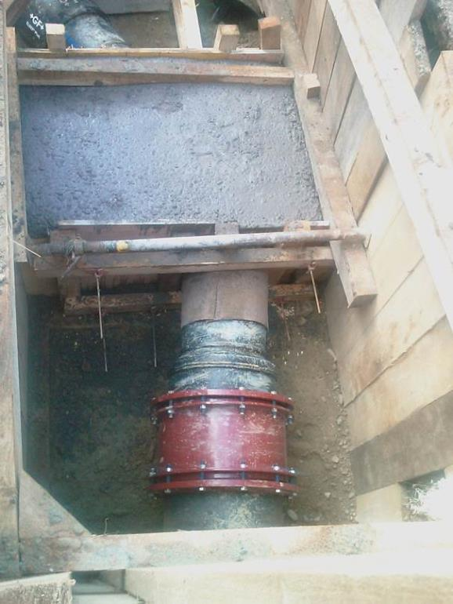
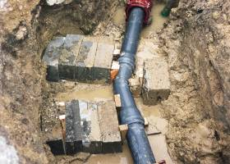
Benefits:
Ease of installation
Saving installation time and cost by making the use of thrust blocks a thing of the past. Thanks to the restraint system.

Slide 10
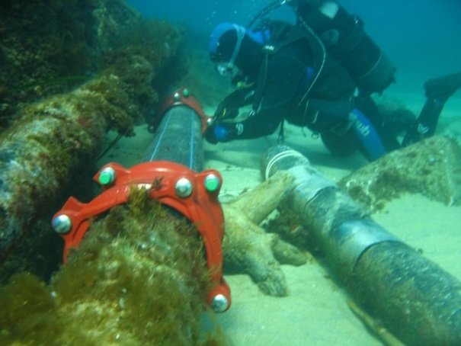
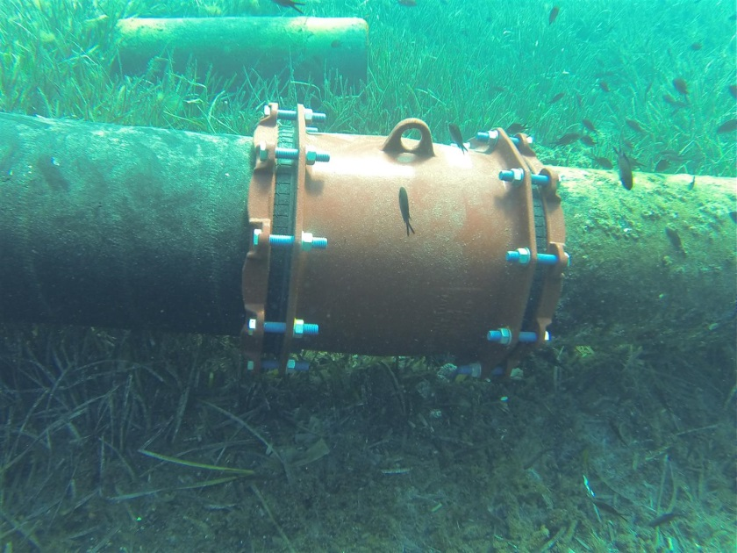
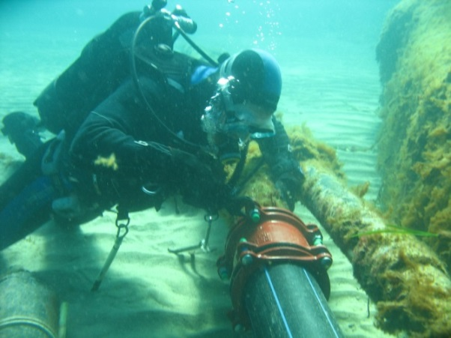
Benefits:
Durable and corrosion proof
Thanks to the use of Resicoat® epoxy powder coating, ductile iron and stainless steel, bolts, nuts and washers!

Slide 11
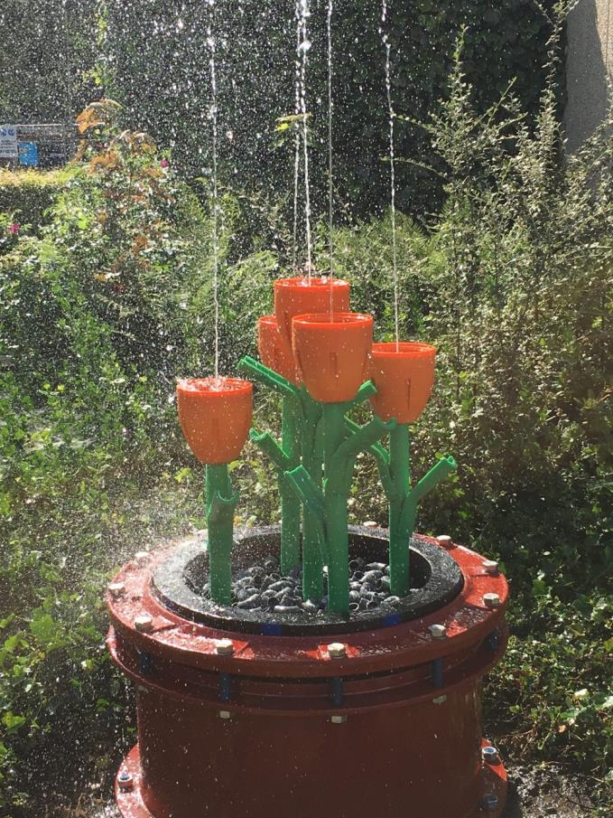
Thank you for your attention

